Slide 1

Prepared by
Dhrutika Rathod

Slide 2
Agenda
What is a Angular 2 ?
What is a Typescript?
Angularjs vs Angular 2.
File Structure
Architecture
Module
Components
Metadata
Template
Directives
Data Binding
Services
Dependency Injection
Advantages and Disadvantages
Websites and Applications in Angular 2
References

Slide 3
What is Angular 2?
Angular 2 is a framework for building applications (SPA)in HTML and either JavaScript or languages like TypeScript that compile to JavaScript.
Angular 2 is not a version upgrade, but a complete rewrite.

Slide 4
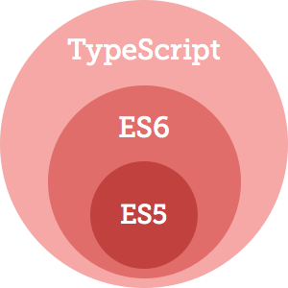
What is TypeScript?
Open source language.
Class-Based object orientation.
Superset of JavaScript.
Transpiles to plain JavaScript.
Strongly typed.
.ts Extension.
Safer code.

Slide 5
Angular 2 Editors
Visual Studio.
Visual Studio Code.
Atom.
WebStorm.

Slide 6
Angularjs vs Angular 2
Angular 2.0 is rewrite and totally different from Angularjs 1.x.
Angular 2.0 is coming with Typescript (ES6).
Object oriented structure in Angular 2.0.
In Angular 2.0, components are basic building block for UI.
There is no concepts of Controller and $scope In Angular 2.0.
Improve dependency injection using Typescript.
Angular 2.0 is not easy to setup as Angularjs 1.x.

Slide 7
Setting Up Our Environment
Npm – Node Package Manager
Set up the Angular 2 application.
Create the package.json file.
Create the typings.json file.
Create the tsconfig.json file.
Create the systemjs.config file.
Create the host Web Page(index.html)
Create an app folder.
Create the main.ts file(bootstrapper)

Slide 8
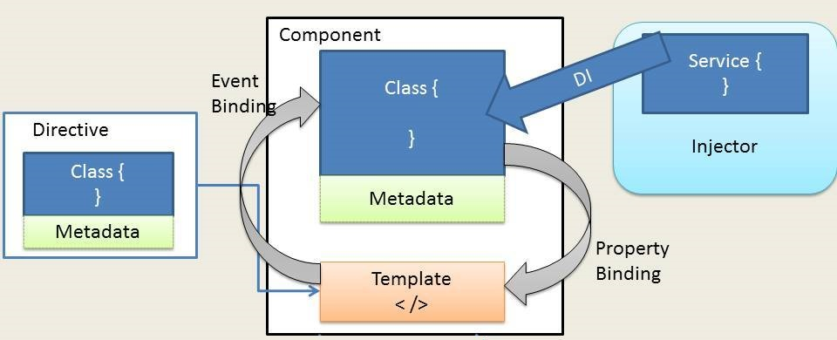
Architecture of Angular 2

Slide 9
Modules
The Angular apps will contain many modules, each dedicated to the single purpose.
Module is a cohesive group of code which is integrated with the other modules to run the application.
Module exports some classes, function and values from its code.

Slide 10
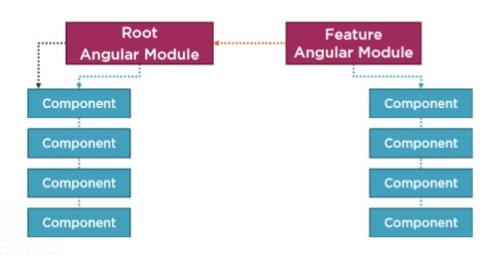
Modules

Slide 11
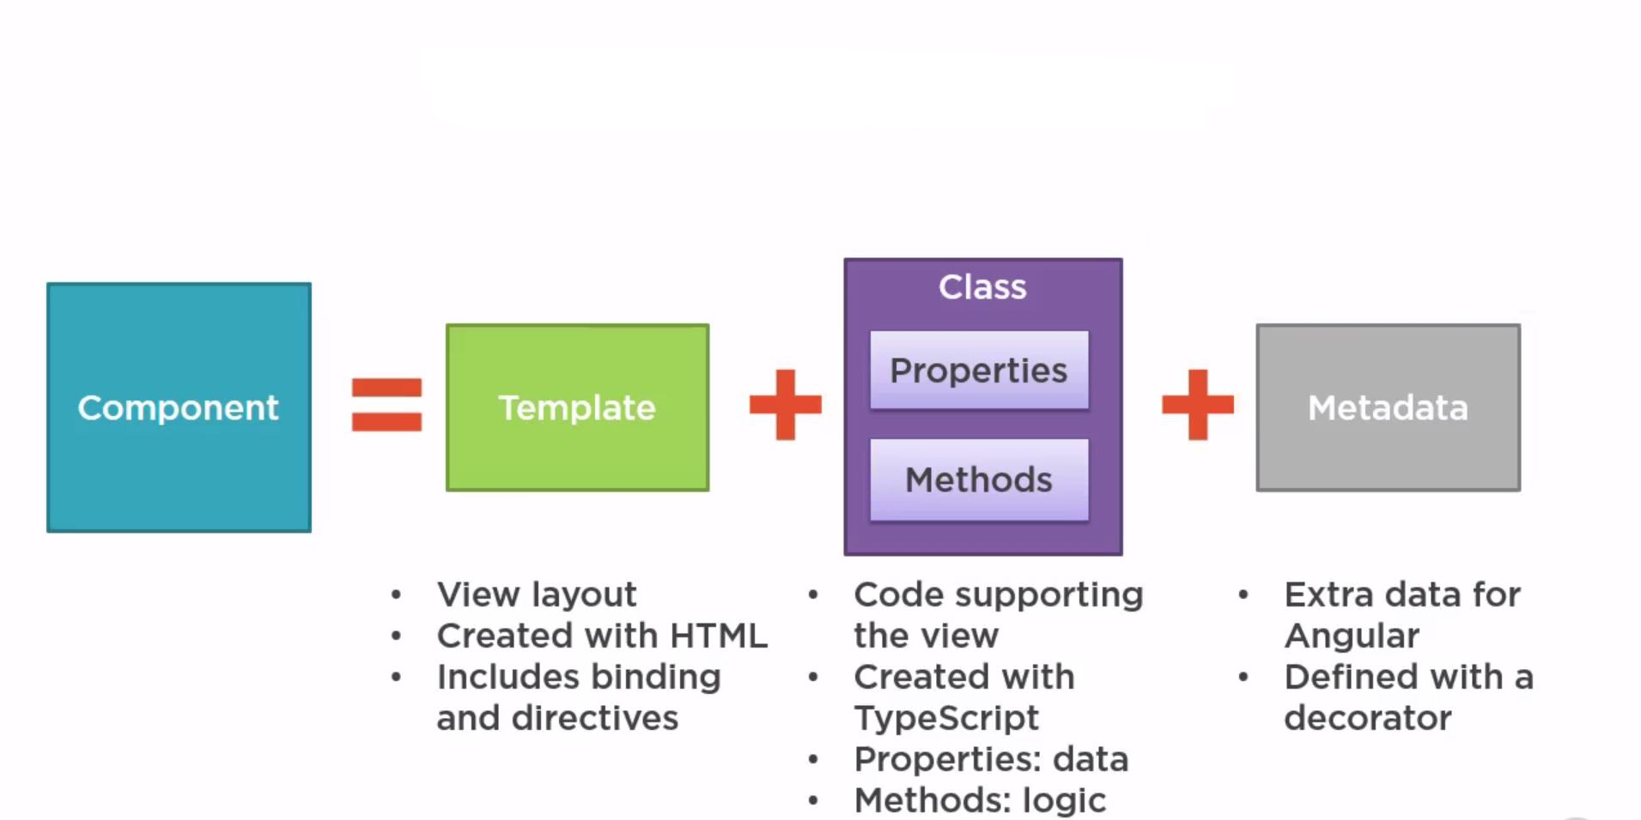
Component

Slide 12
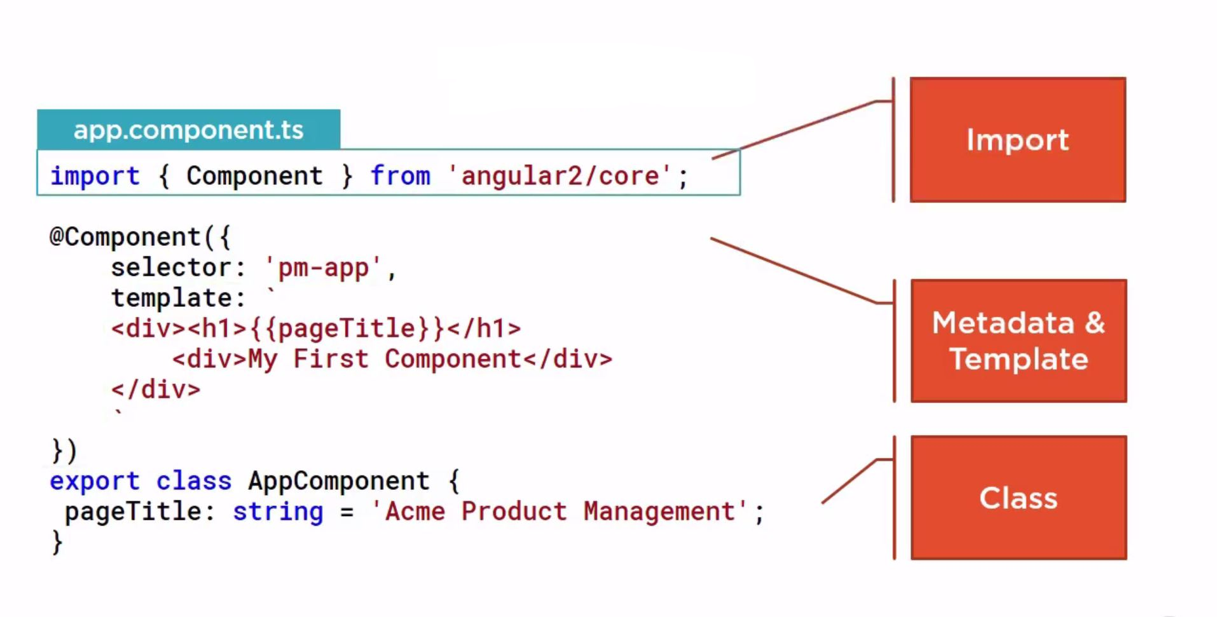
Component Detail

Slide 13
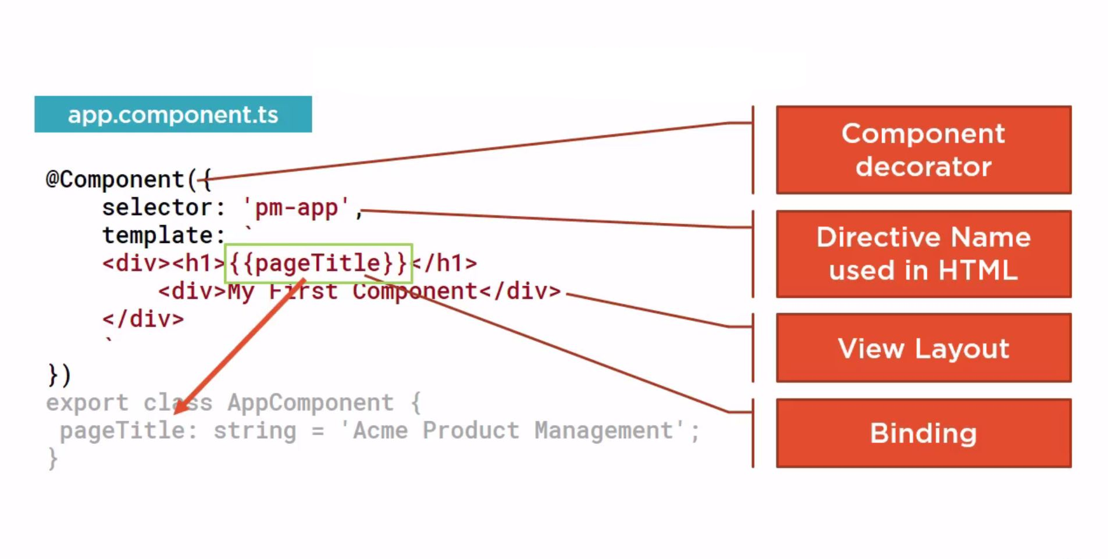
Metadata

Slide 14
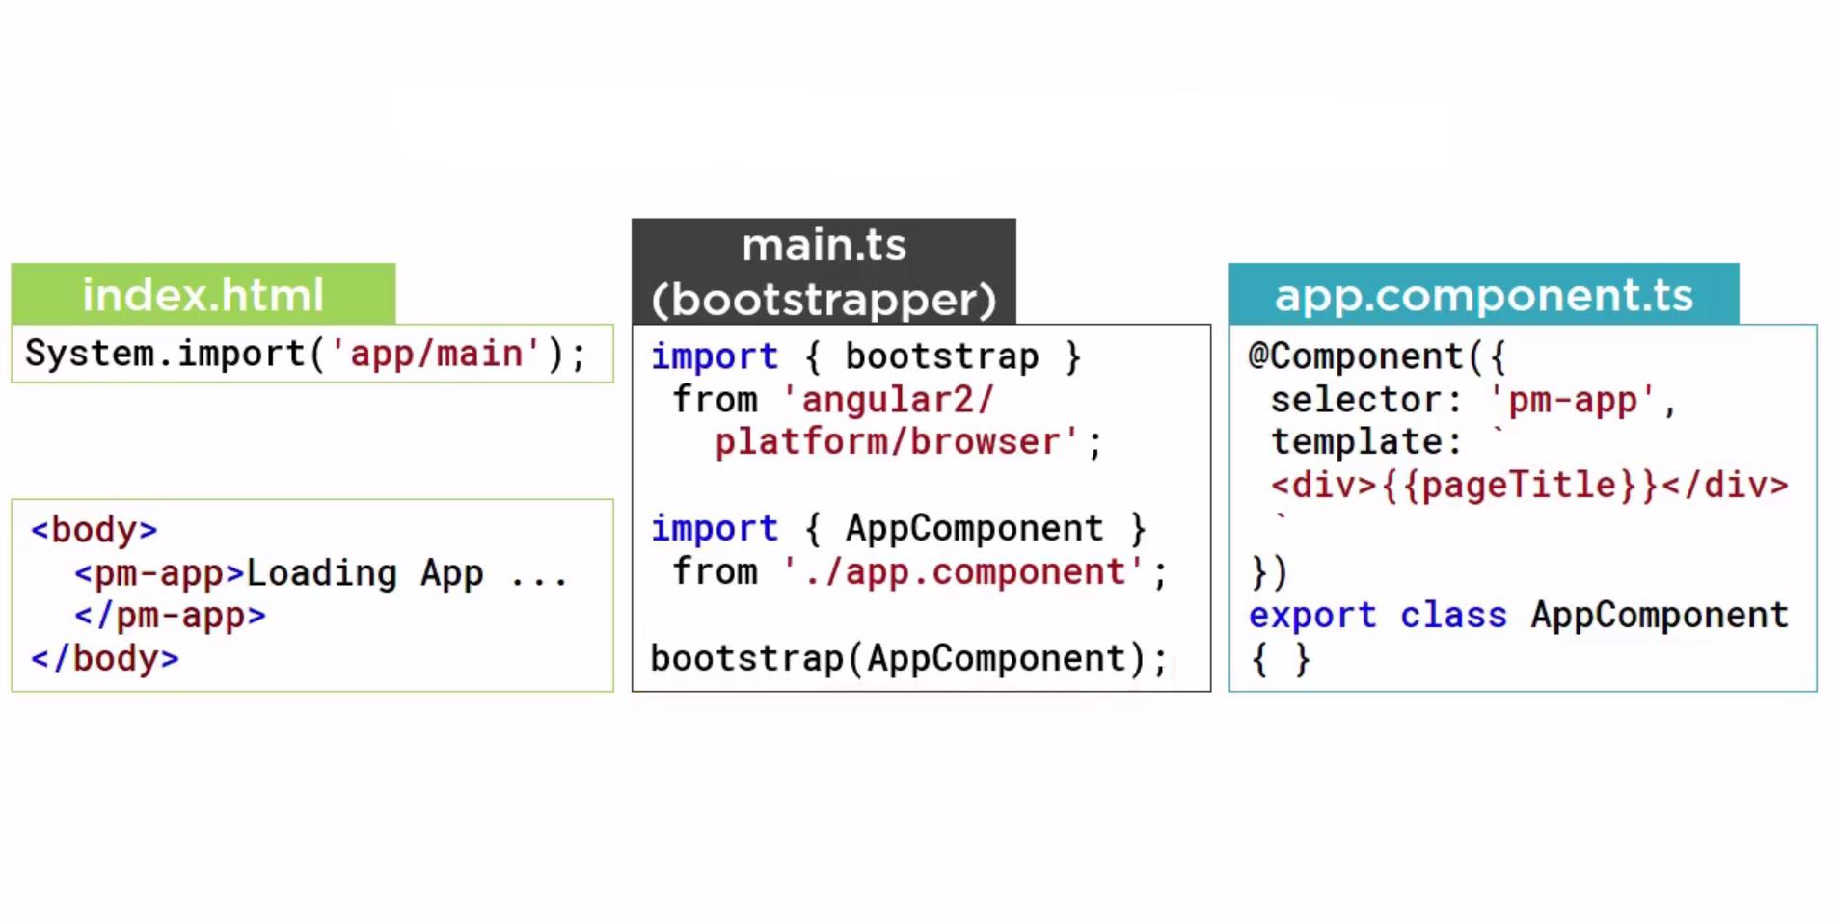
Defining a Template in Component

Slide 15
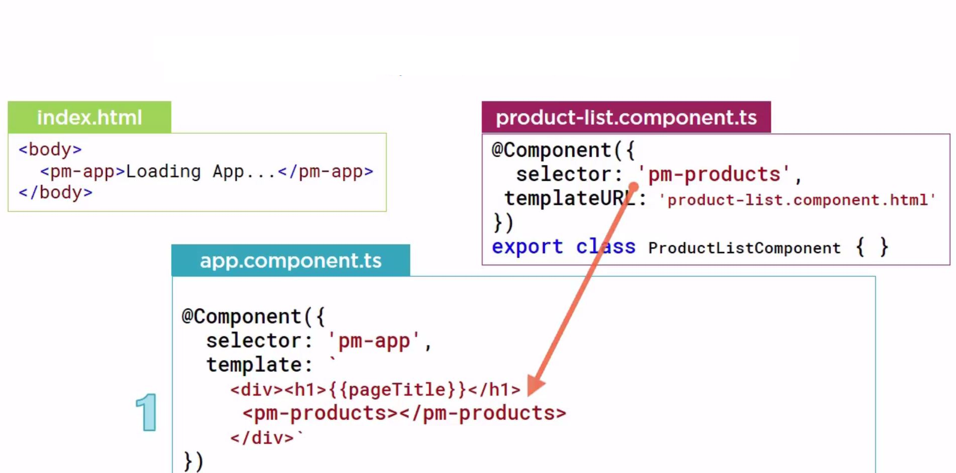
Using a Component as a Directive For Add Step 1

Slide 16
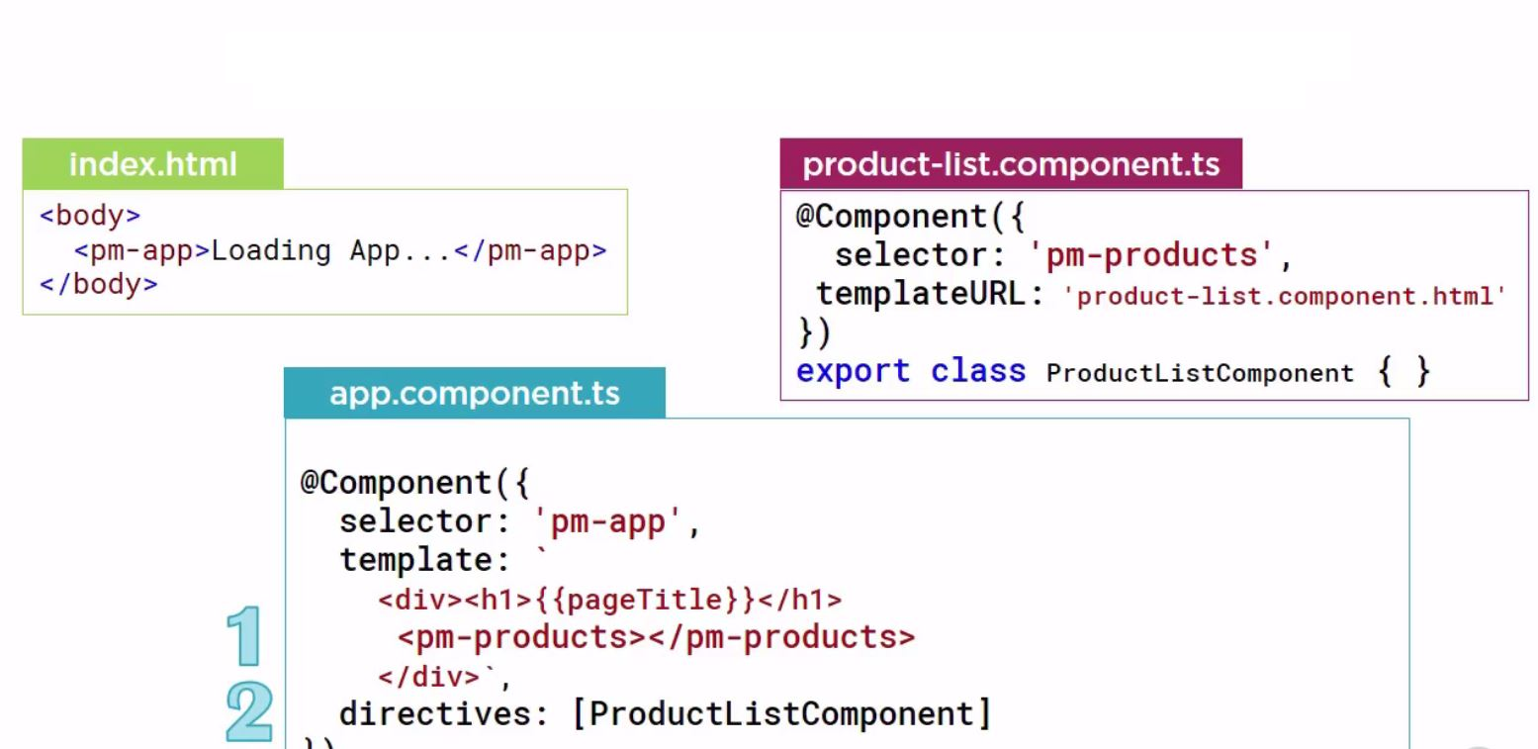
Using a Component as a Directive For Add Step 2

Slide 17
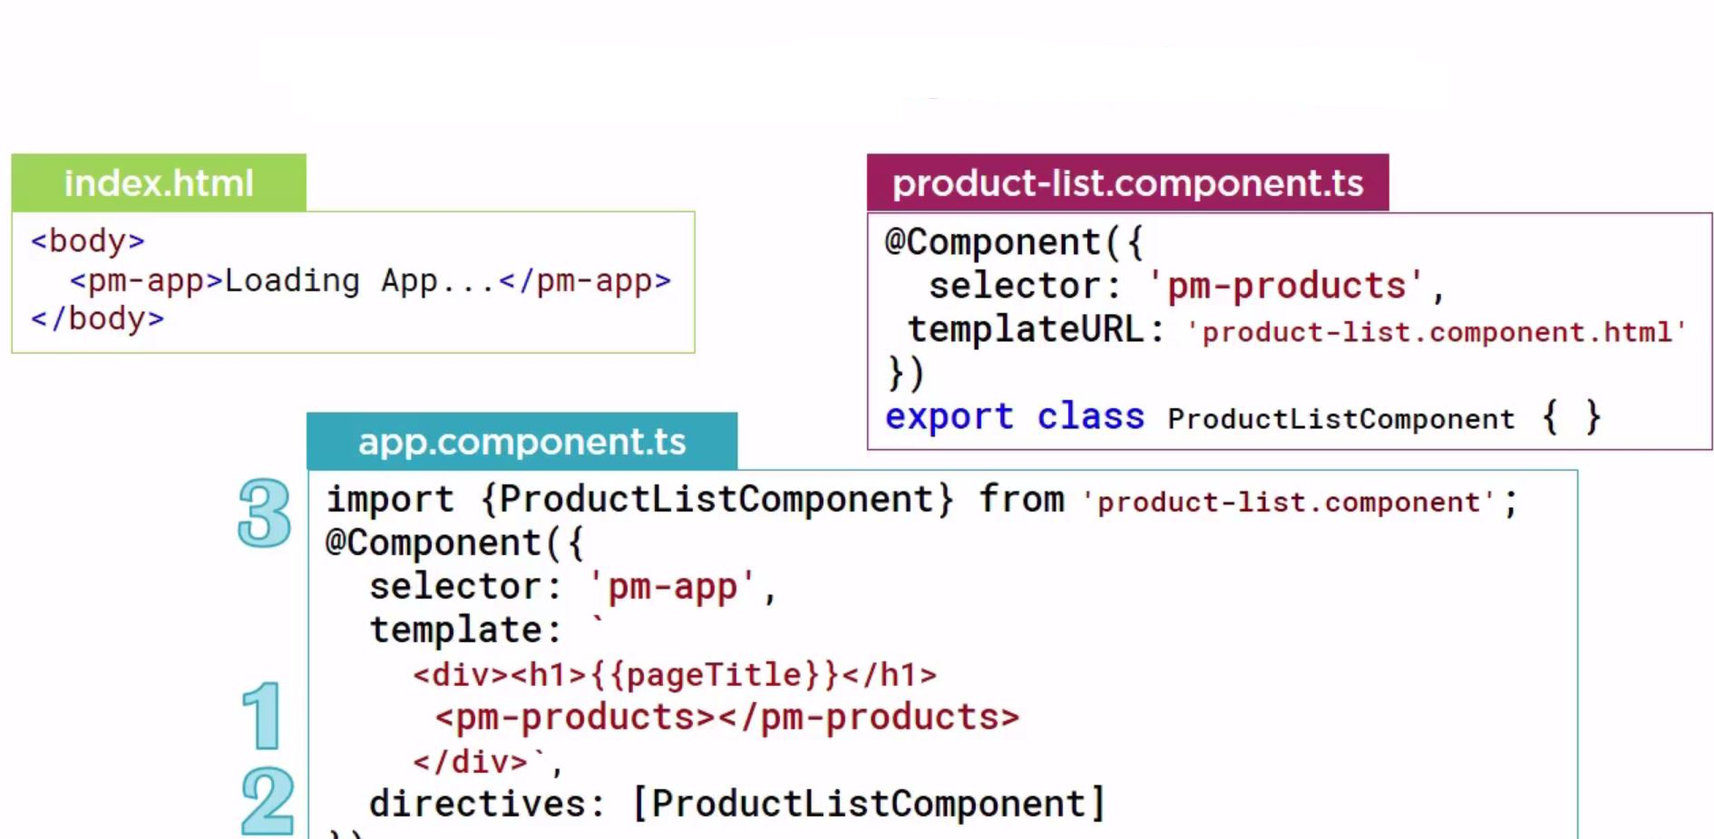
Using a Component as a Directive For Add Step 3

Slide 18
Directive
A directive is a TypeScript Class with a metadata.
Directives may or may not have a template attached. Component is an example of a directive with a template.
There are three kinds of directives in Angular.
Components
Structural directives
Attribute directives

Slide 19
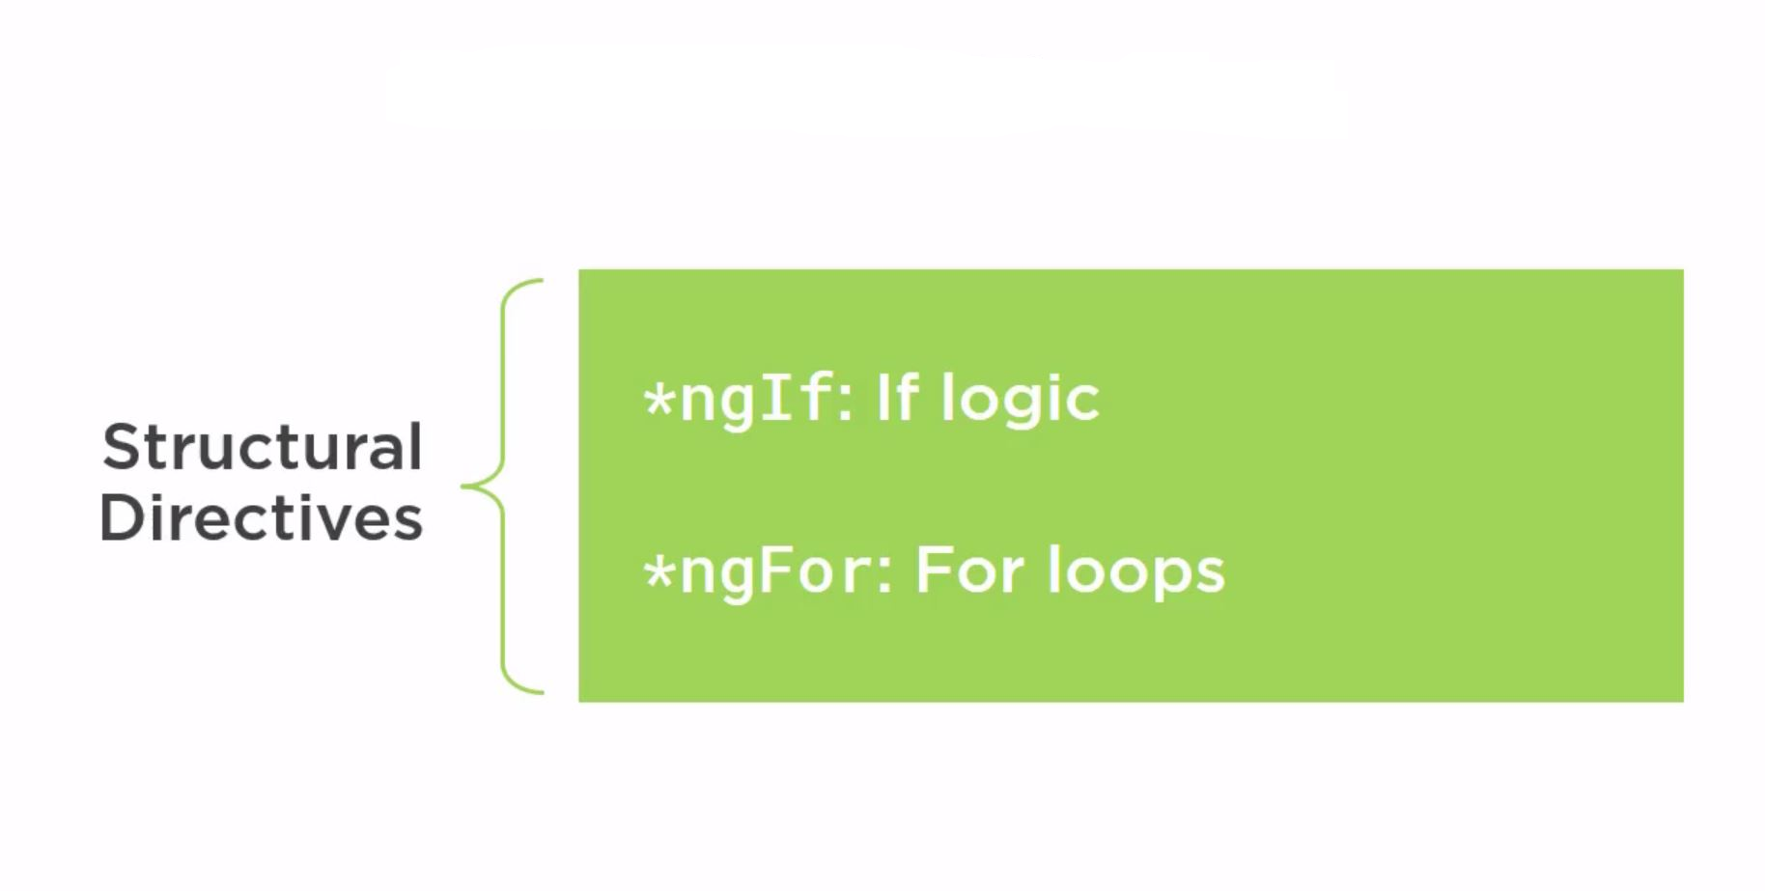
Structural Directive

Slide 20
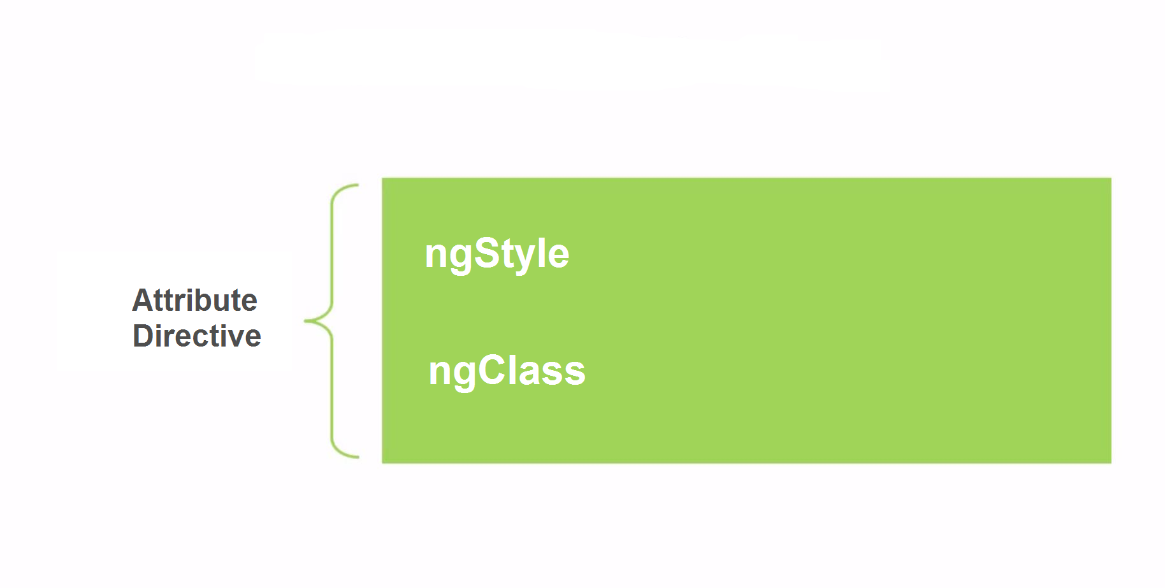
Attribute Directive

Slide 21
Data Binding
Property Binding
Handling Events with Event Binding
Handling Input with Two-way Binding

Slide 22
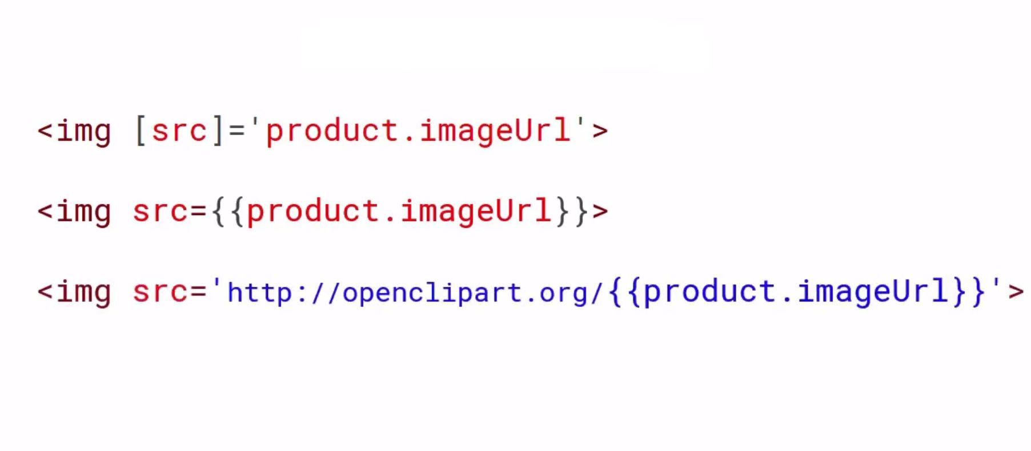
Property Binding Example
Picture title here

Slide 23
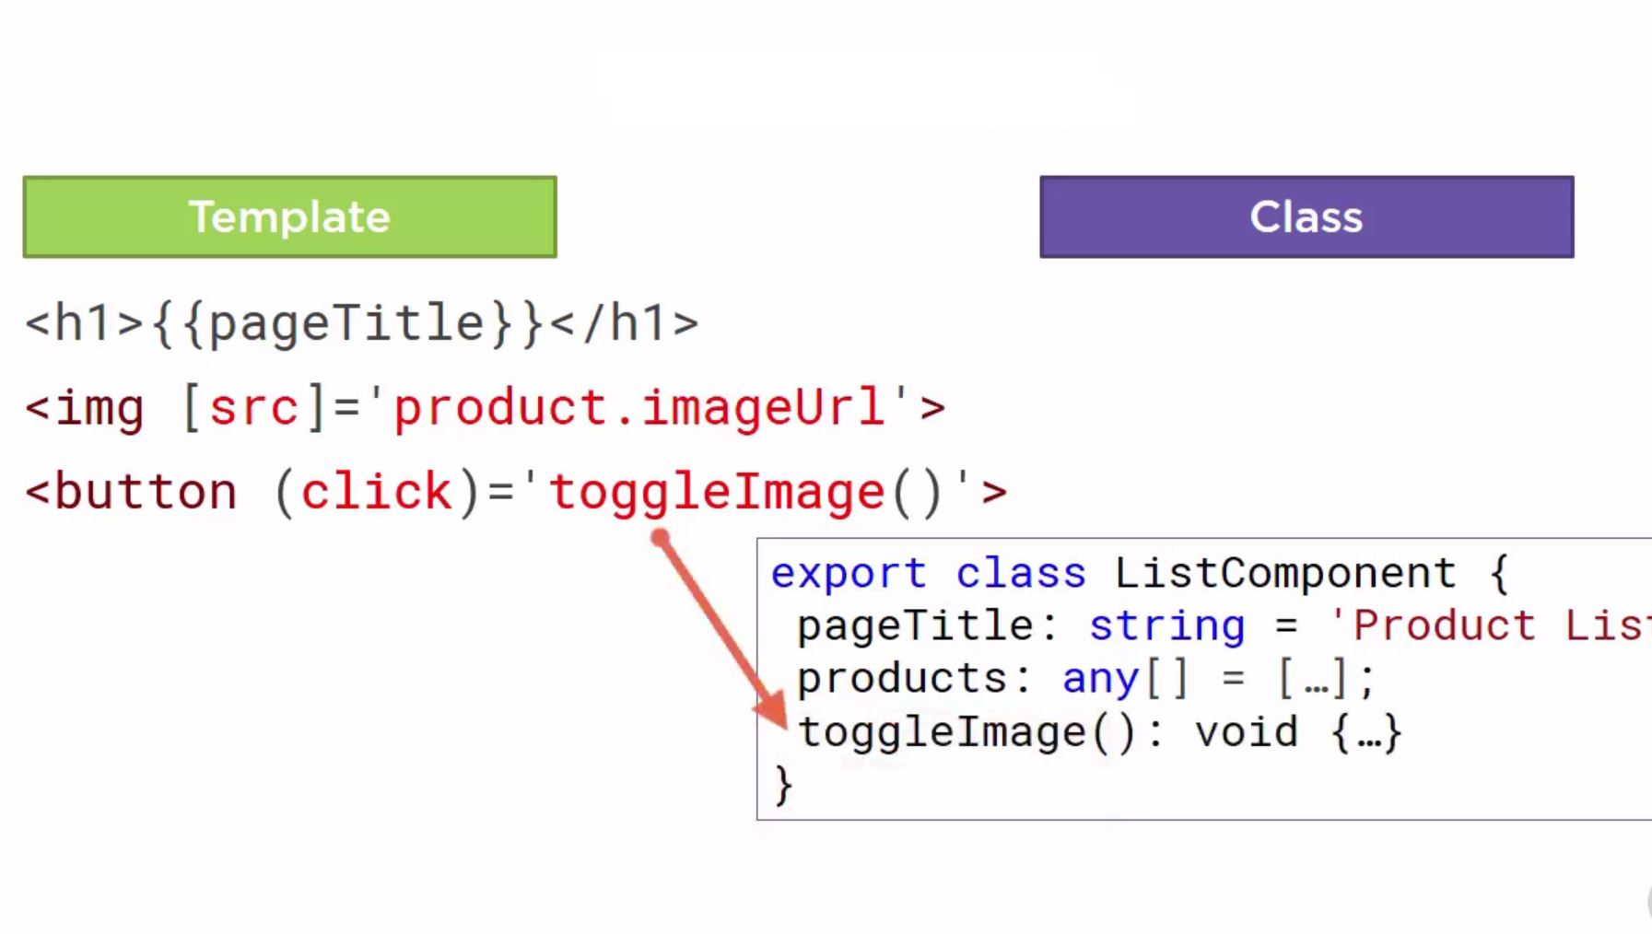
Event Binding
Picture title here

Slide 24
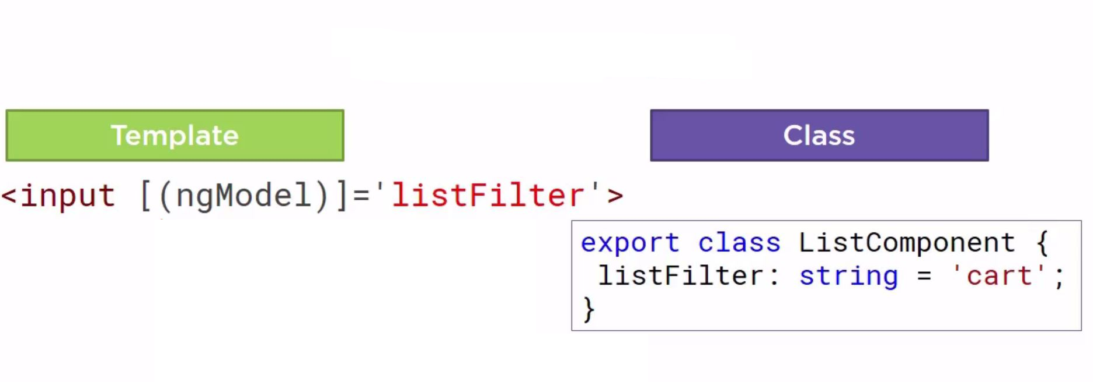
Two Way Binding
Picture title here

Slide 25
Services
Service in Angular is a function or an object that can be used to
share the data across the application.
Services are JavaScript functions that are responsible for doing a specific task only.
Angular services are injected using Dependency Injection mechanism and include the value, function or feature which is required by the application.
There is no ServiceBase class in Angular.
Picture title here

Slide 26
Dependency Injection
Dependency Injection is a design pattern that passes an object as dependencies in different components across the application.
Components need to use services to perform tasks, and these services are injected into the component via the injector. The injector provides the instance of the service, so that it can be used in the component.
Picture title here

Slide 27
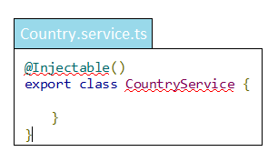
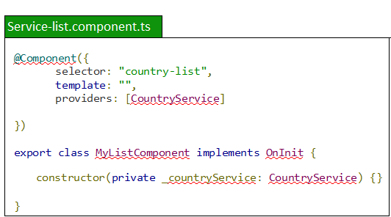
Services and DI
Picture title here

Slide 28
Advantages of Angular 2
Better performance – Faster and Easier.
Single page application
Cross platform framework.
Code structure is very simplified.
Typescript support (OOP).
Directly uses the valid HTML DOM element properties and events.
Two way data binding using [ngModel],
Dependency Injection
Flexible and strong Routing.
Unit Test.
Picture title here

Slide 29
Disadvantages of Angular 2
Angular is complicated at beginner level.
The lifecycle of Angular application is complex.
If browser disable the Javascript then application will not work
Picture title here

Slide 30
Websites and Apps in Angular 2
Angular 2 Admin panel Framework
Instagram Filters
Minesweeper Game
Material Kit Pro
Youtube Search Engine

Slide 31
References
https://angular.io/docs/ts/latest/tutorial/
https://www.youtube.com/watch?v=zj7_4VDFQPA&index=1&list=PLC3y8-rFHvwg5gEu2KF4sbGvpUqMRSBSW
https://www.tutorialspoint.com/angular2/index.htm
Picture title here

Slide 32
Thank You!!! ☺

